Slide 1
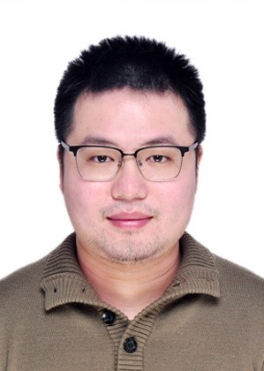


Robust d-wave superconductivity from the Su-Schrieffer-Heeger-Hubbard model: possible route to high-temperature superconductivity
Hao-Xin Wang
Tsinghua University
Oct 31st , 2022
to be submitted
Collaborators:
Yifan Jiang
(ShanghaiTech University)
Hong Yao
(Tsinghua University)
Notes:
Dear All, good morning, My name is Hao-Xin. Thanks for listening my talk about our recent study of the superconductivity of Hubbard model with electron-phonon interaction. This work is collaborated with Professor Yifan Jiang, and My advisor Hong Yao. (Thanks for their contributions to this project.)

Slide 2
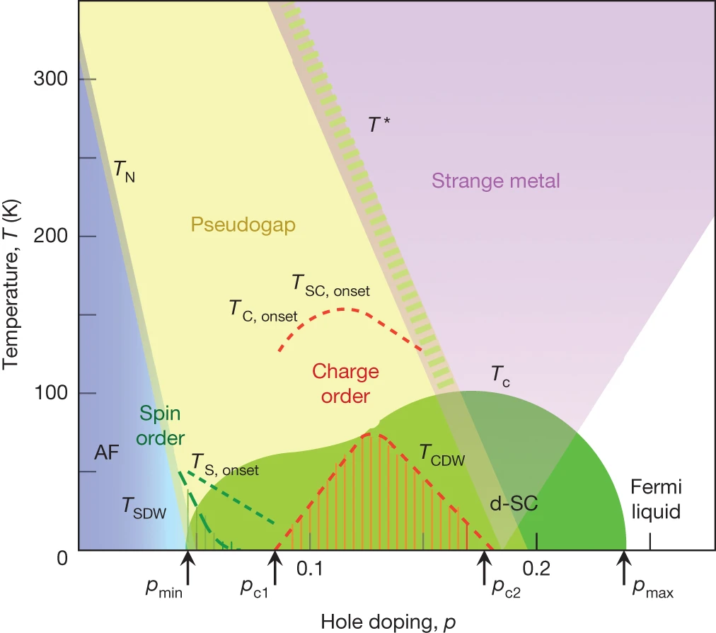
Introduction
It has been nearly forty years since the experimental discovery of high-temperature superconductivity. [J. G. Benordz and K. A. Muller, 1986]
However, consensus about the microscopic mechanism for d-wave high-temperature SC has not been reached yet, which remains a key challenge in studies of strongly-correlated electronic systems
In past several years, growing numerical studies suggest that the simplest Hubbard model with strong Hubbard interactions in doping range rele- vant for hole-doped cuprates exhibits stripe order or phase separation but no d-wave superconductivity in the ground state. [Mingpu Qin, Chia-Min Chung, Hao Shi, Ettore Vitali, Claudius Hubig, Ulrich Schollwöck, Steven R. White, and Shiwei Zhang, PRX 2020]
Cuprate phase diagram
[ B. Keimer, S. A. Kivelson, M. R. Norman,
S. Uchida, J. Zaanen, Nature 2015]
Notes:
So, as beginning, I will give an introduction about some theoretic researches about High Tc superconductivities. As we can see, the most phases in Cuprate
include SC, strange metal, are not understood well up to now.
(It’s a consensus /kənˈsɛnsəs/)
The simplest model to describe the strongly correlated fermion systems, is the one-band hubbard model.
Although….
Thus….
| ˌindəˈspensəb(ə)l
Thus, it is indispensable to introduce further terms beyond the simplest Hubbard model, if one want to obtain a d-wave superconductor state when doping.
Absence of superconductivity in the pure two-dimensional Hubbard model, Phys. Rev. X 10, 031016, Mingpu Qin et al.

Slide 3
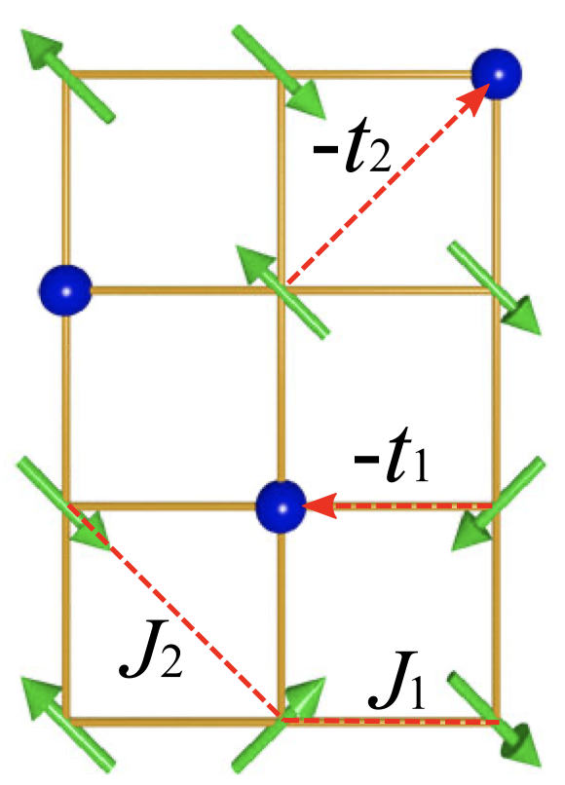
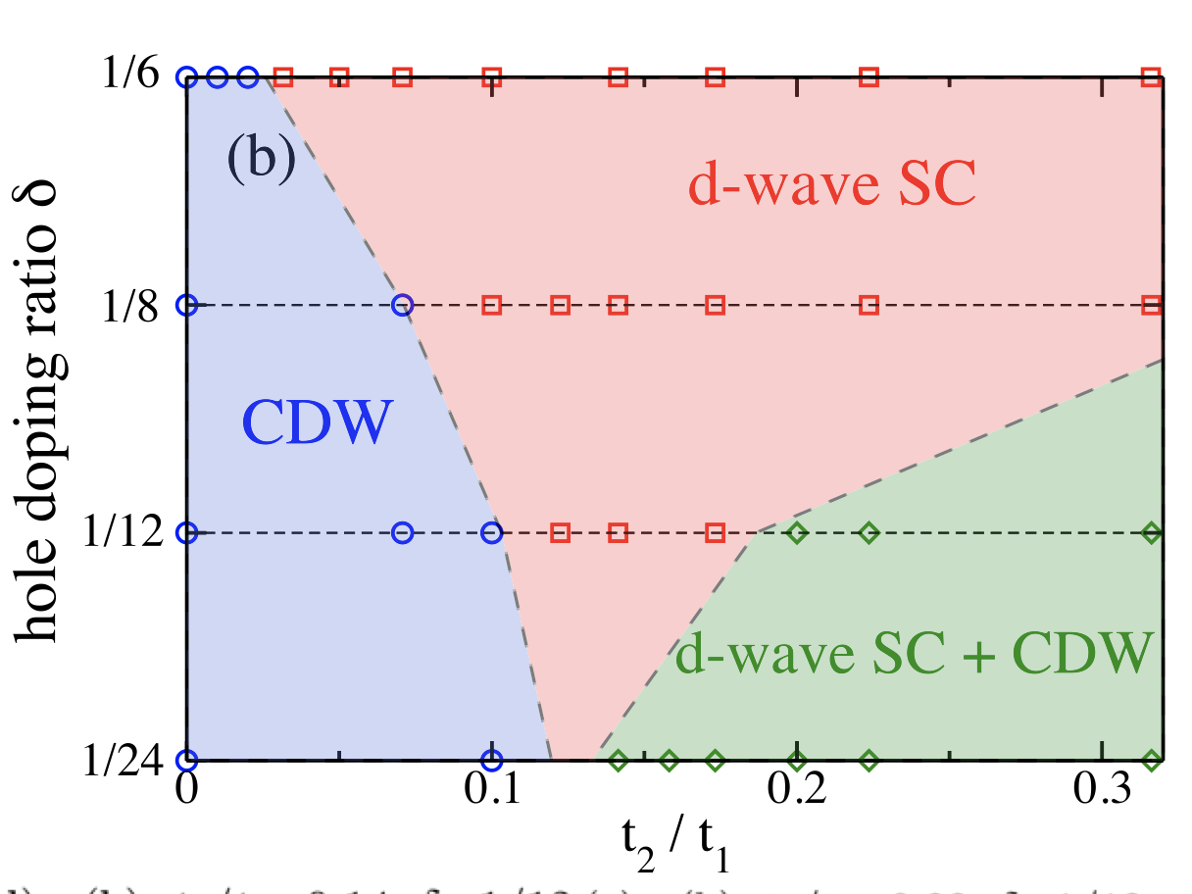
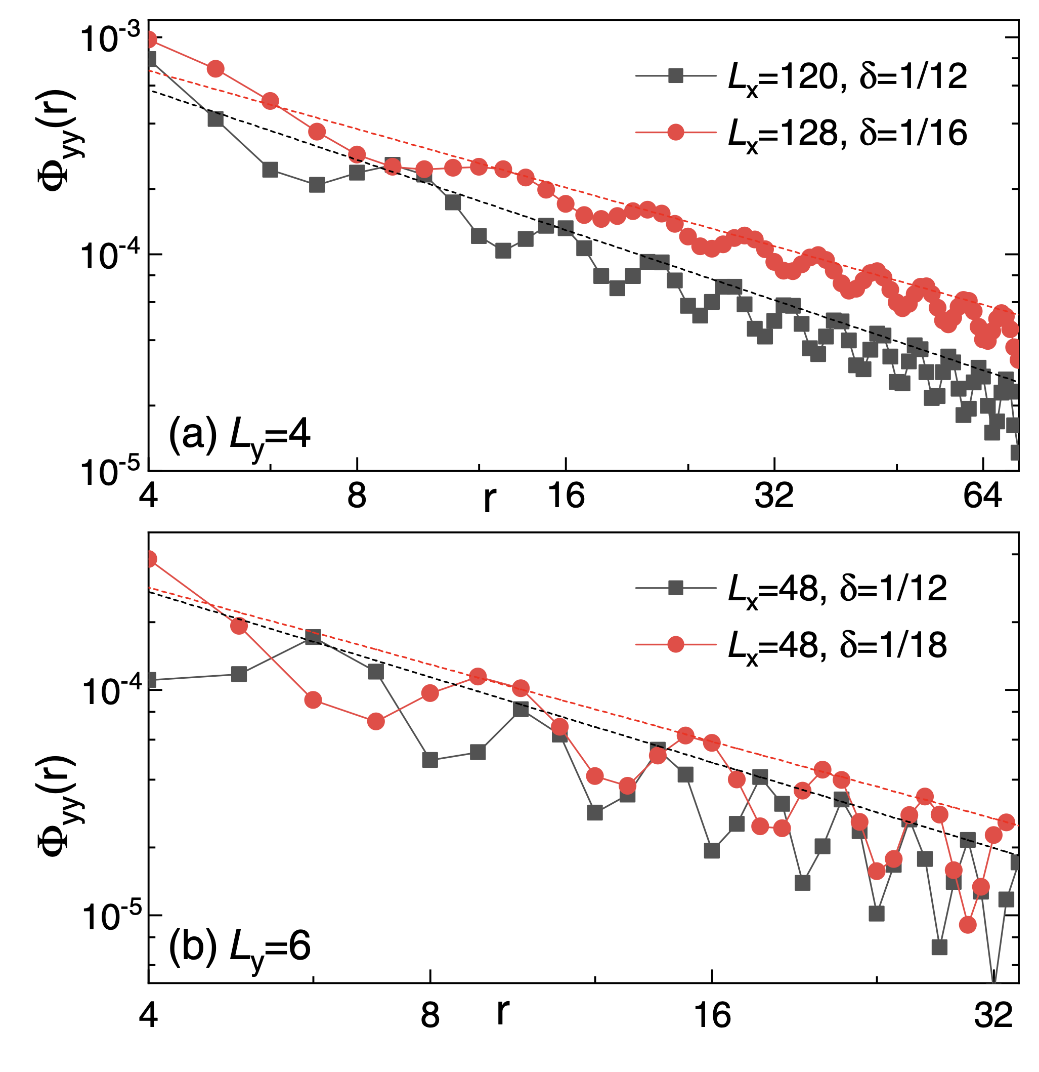
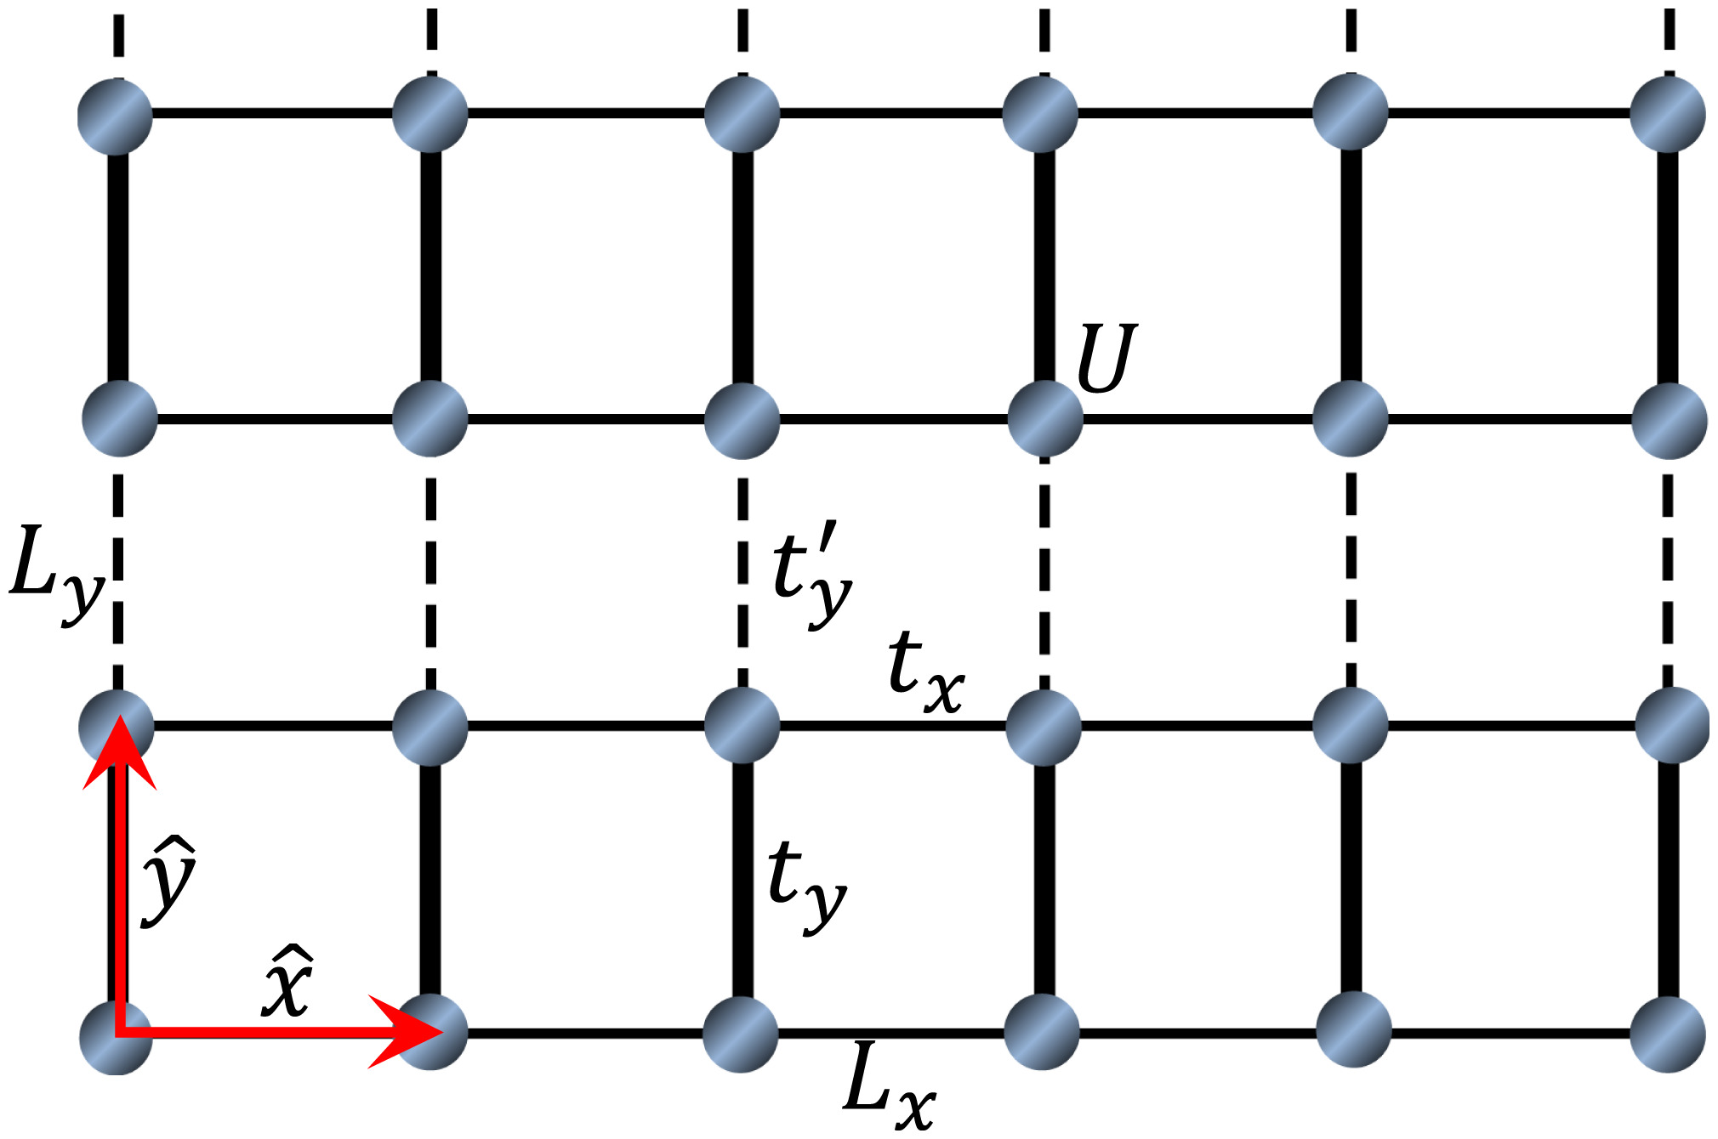
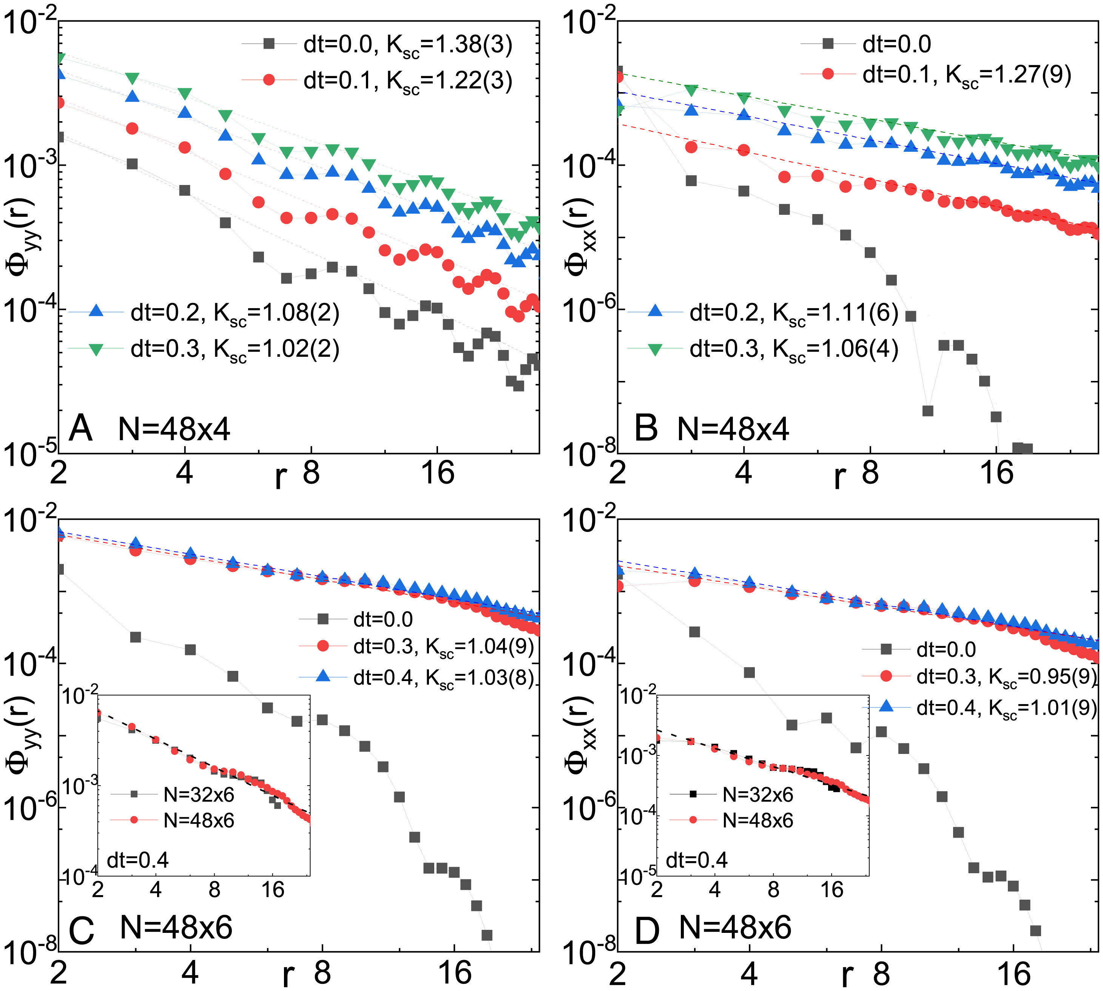
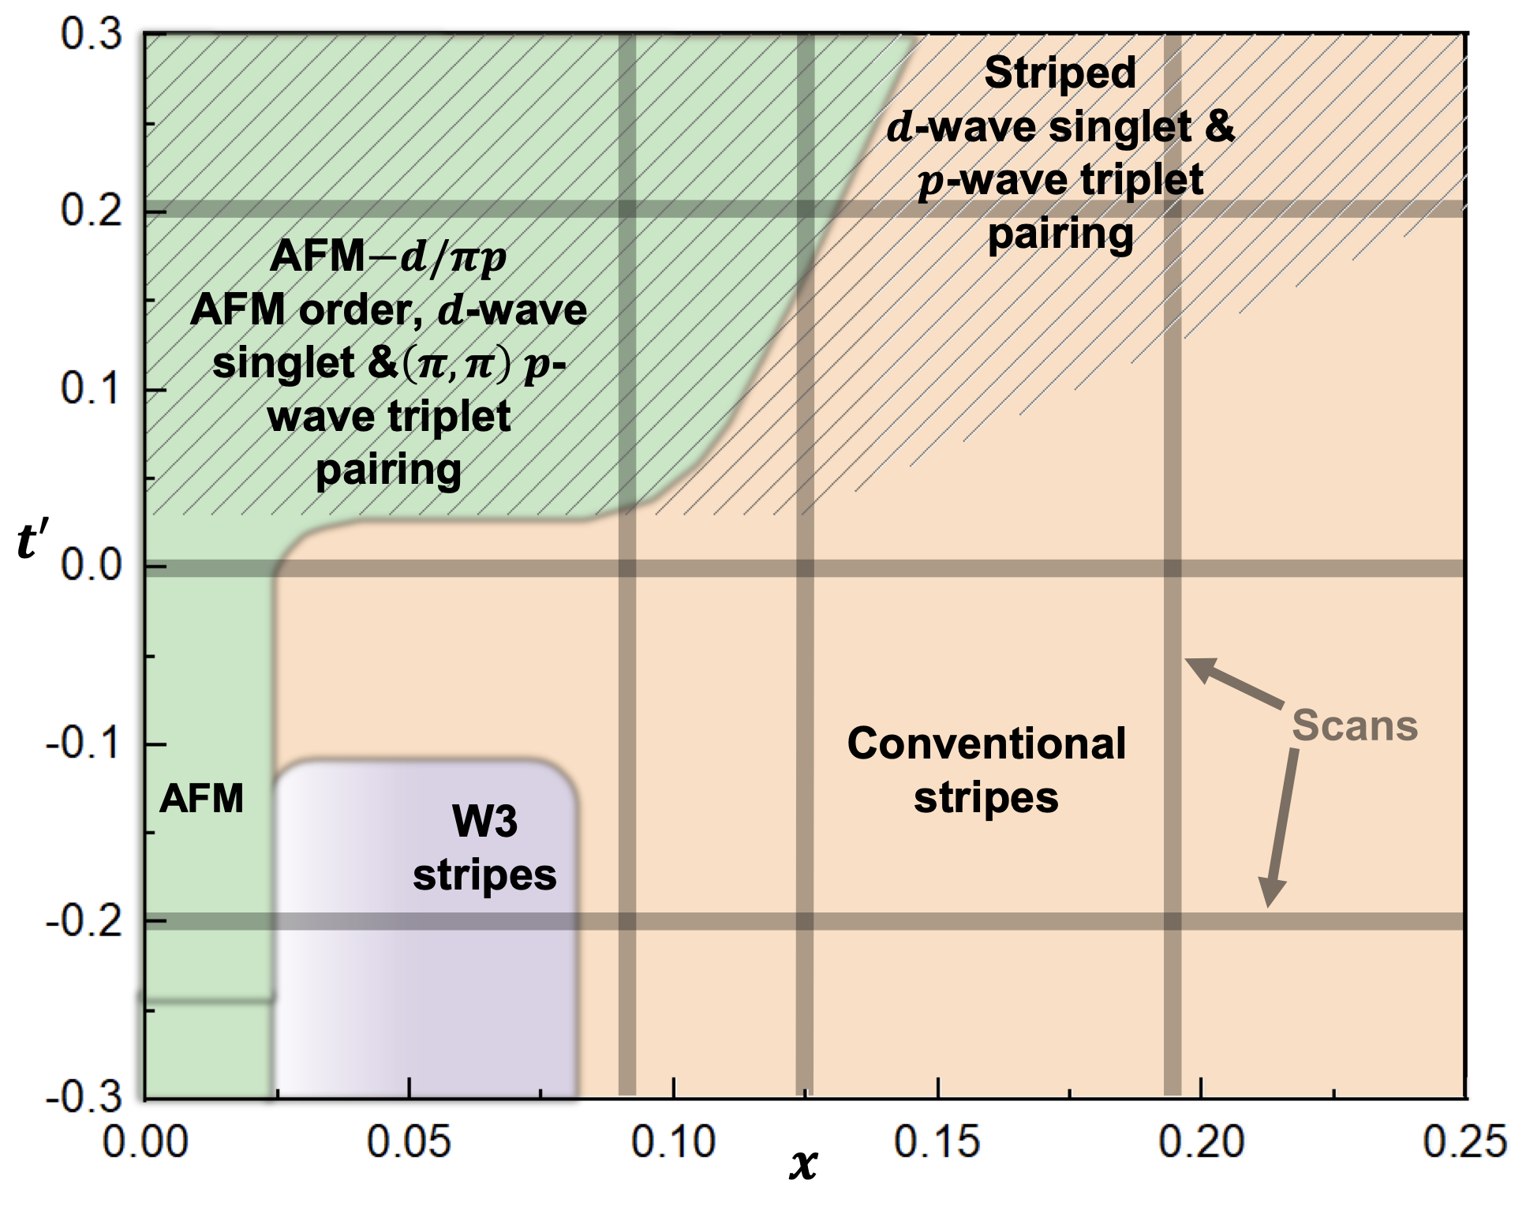
What more is needed beyond the Hubbard model?
next nearest neighbor hopping t₂
dope the J1-J2 spin liquid
stripe order
Hong-Chen Jiang and S. A. Kivelson PRL 2021
HC Jiang and S.A. Kivelson, PNAS 2021
Shoushu Gong, W. Zhu, and D. N. Sheng, PRL 2021.
Shengtao Jiang, D. J. Scalapino, and S. R. White, PNAS 2021
Notes:
非常自然的想提出一个问题，就是beyond the Hubbard model, 什么样的相互作用形式，会帮助形成d波超导体。
There have been some researches investigating the further range terms in Hubbard or t-J models. One is the NNN hopping t2. In a DMRG research, the author suggests a positive t2 could induce a d-wave superconductor phase, or d-wave superconductor mixed with charge density wave phase. Another calculation confirms this results, but they also shows that with a negative t2,(or t’ in this work), corresponding to the hole dope in Cuprate, can not give a SC state, which violates | BrE ˈvʌɪəleɪt, AmE ˈvaɪəˌleɪt |
with the experiments.
And there are also some works revealing that either doping a J1-J2 spin liquid or the stripe order could give a quasi long range superconductor orders.

Slide 4
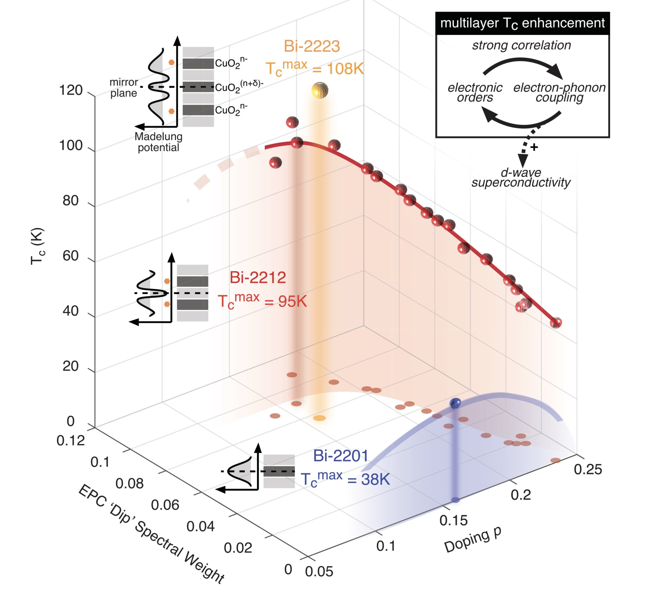
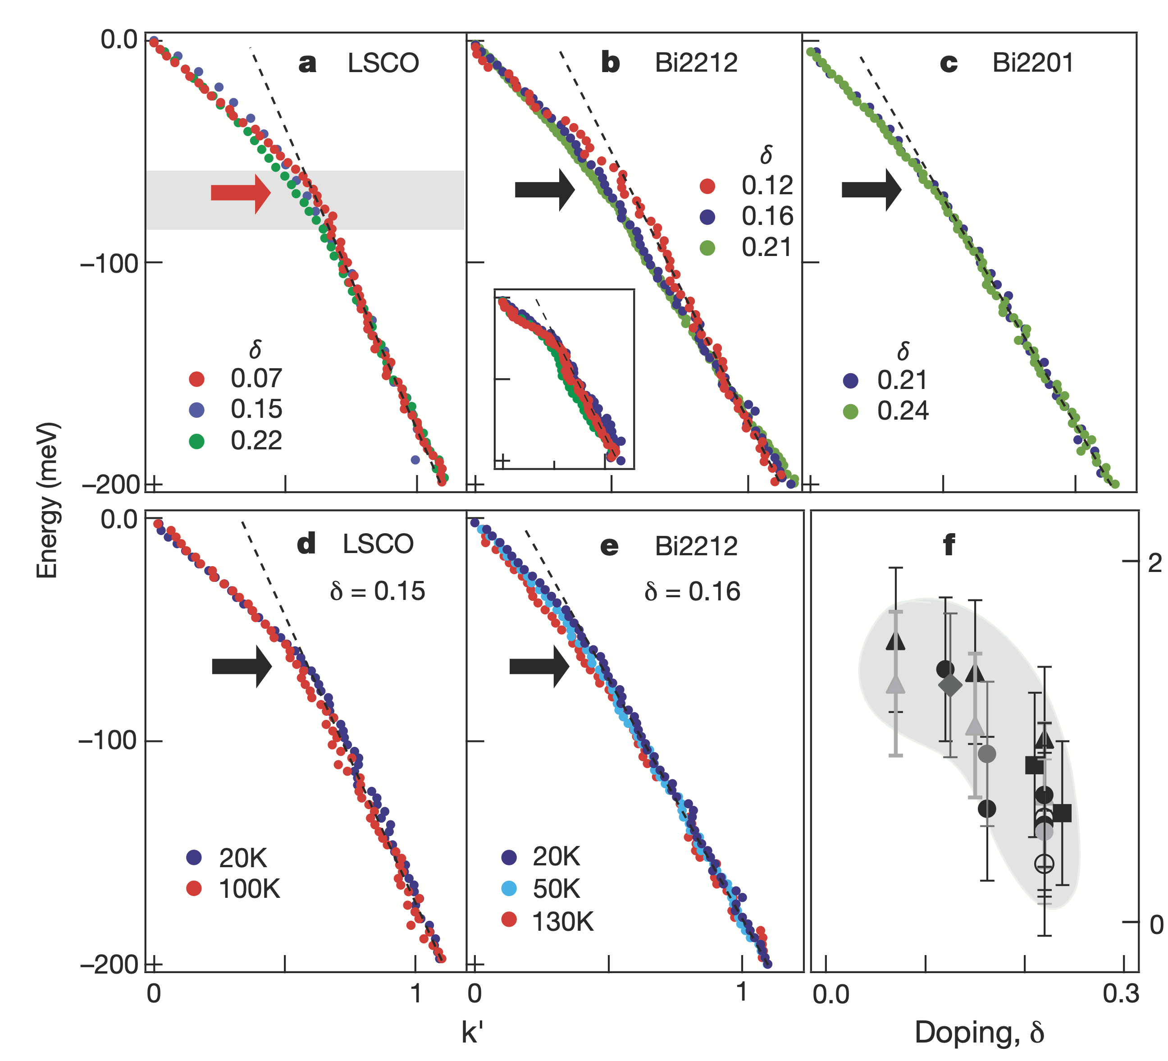
Electron-Phonon Coupling (EPC)
EPC drives the formation of Cooper pairs in conventional superconductivity.
Increasing experiments indicate that EPC can be an essential ingredient in high T_{c} superconductors, including cuprates and iron-based superconductors.
intertwined growth of the superconductivity and EPC
[Y. He, Z.-X. Shen et al.,Science (2018)]
ubiquitous EPC in cuprates
[A. Lanzara, Z.-X. Shen et al. Nature (2001)]
Notes:
Another consideration is the electron-phonon couplings. As we all known, the EPC plays an important role in the formation of cooper pairs in the conventional superconductivities.
Recently, increasing experiments indicate that …
In unconventional superconductors, there are increasing experiments indicate the EPC can be an essential ingredient to understand the superconductivities.
In the left figure, the authors show the EPC is ubiquitous in cuprate materials. And another work suggests at different number of layer of Copper Oxide plane, the Tc and the EPC has a pronounced correlation. They are intertwined when changing the doping levels.

Slide 5
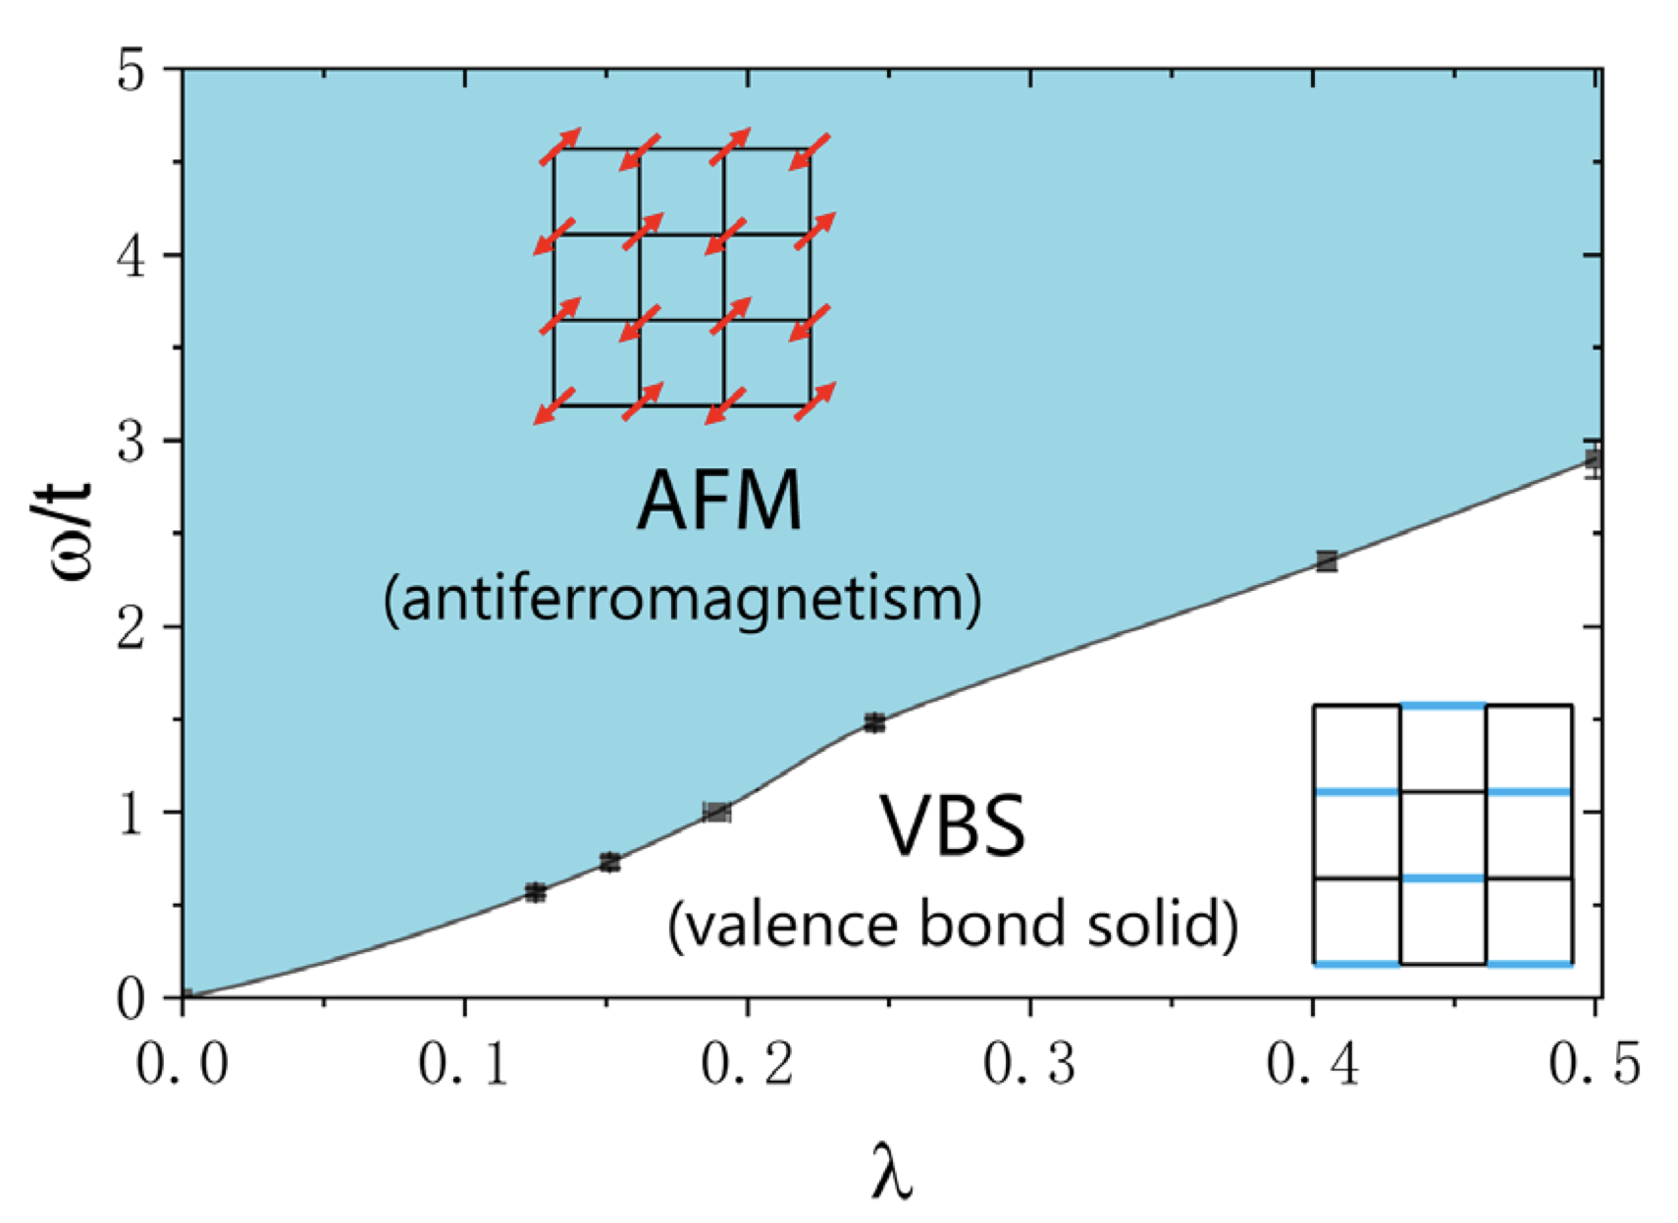
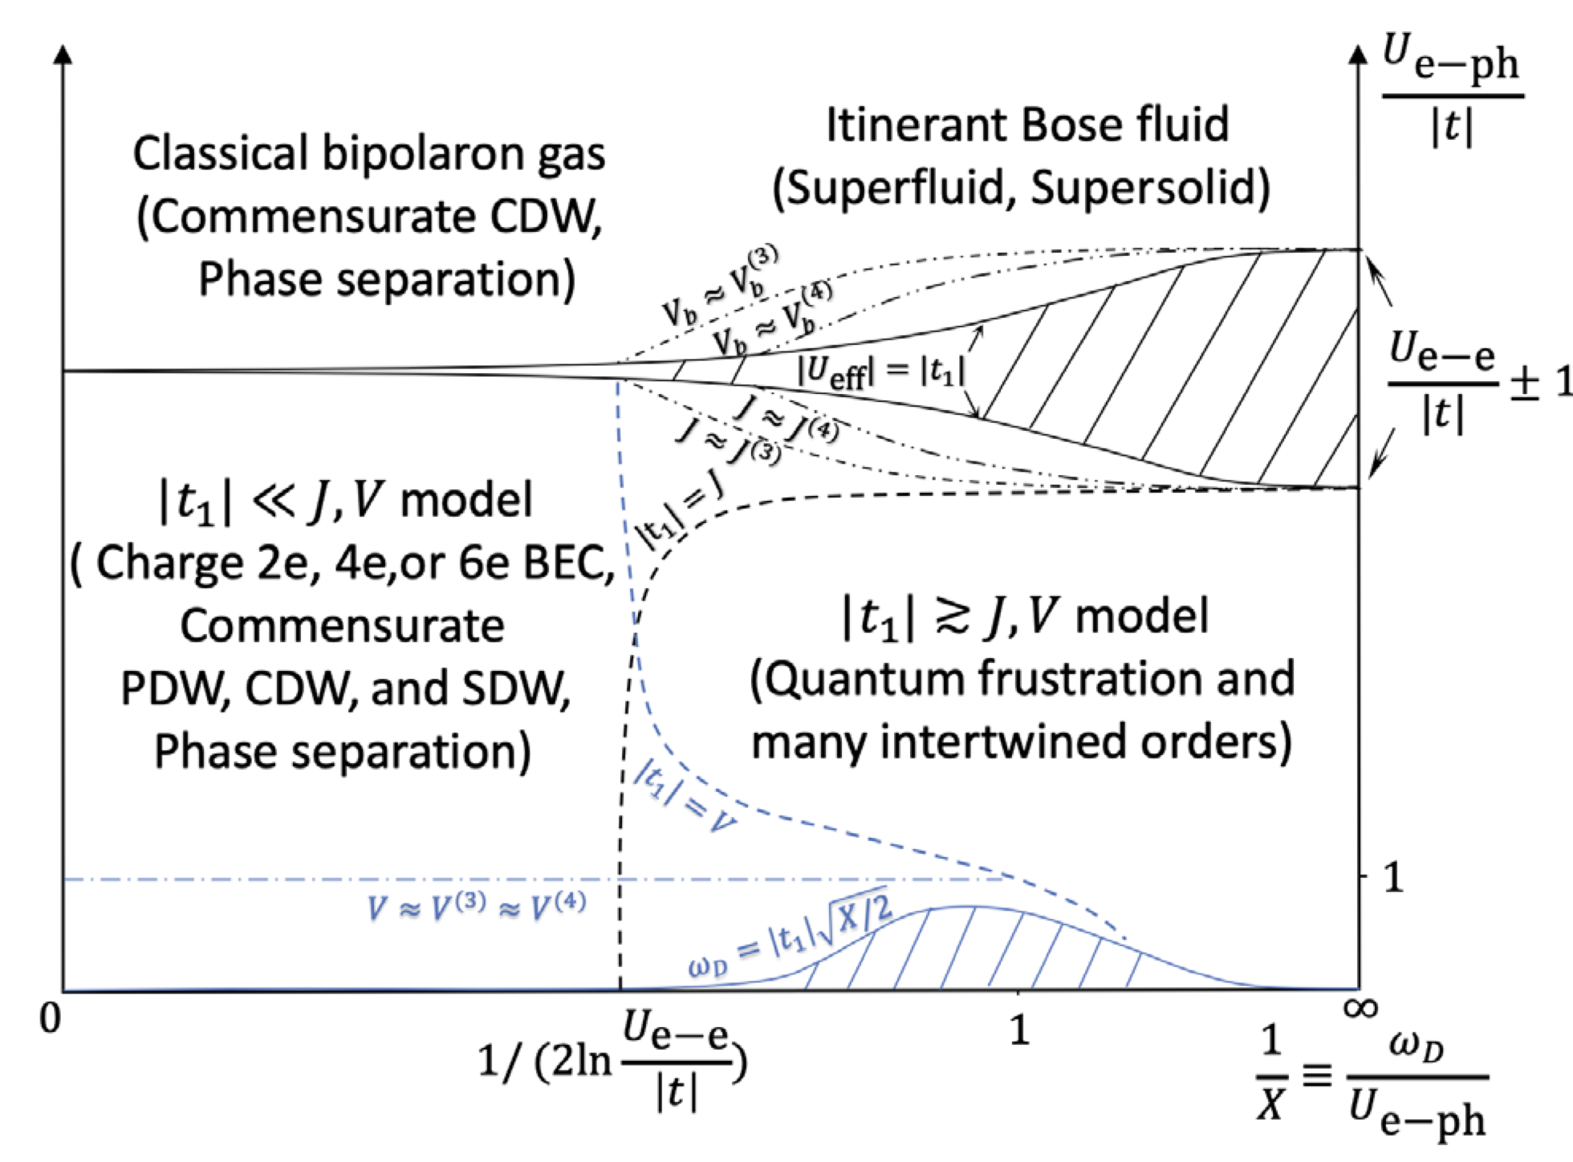
Electron-Phonon Coupling (EPC)
Theoretical studies also suggest EPC can drive some exotic phase such as antiferromagnetism and pair-density wave.
Su-Schrieffer-Heeger (SSH) Model
Holstein-Hubbard Model
Xun Cai, Zi-Xiang Li, and Hong Yao
PRL (2021)
Z. Han, S. A. Kivelson, and H. Yao, PRL (2020).
Question: in a one-band Hubbard model , can EPC help to drive a d-wave superconductor state?
Notes:
为什么会考虑电声体系对于超导的影响，第一点是刚才提到的，越来越多的实验和理论支持电声相互作用会对超导有影响，包括铜基超导和铁基超导；第二点是电声子相互作用能诱导反铁磁序，我们通常会有一种想法就是反铁磁涨落可以诱导超导体，所以我们希望电声相互作用也可以帮助形成超导序。

Slide 6
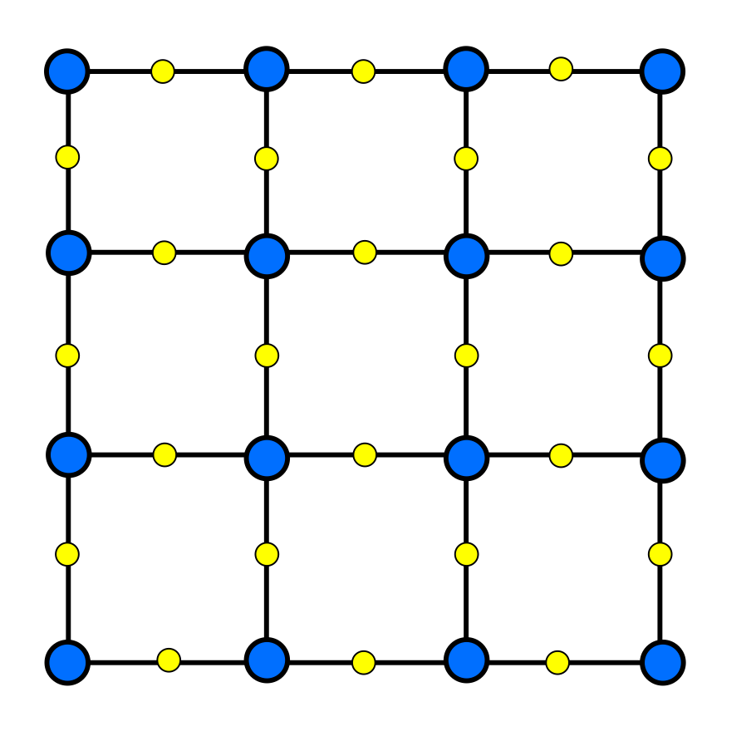
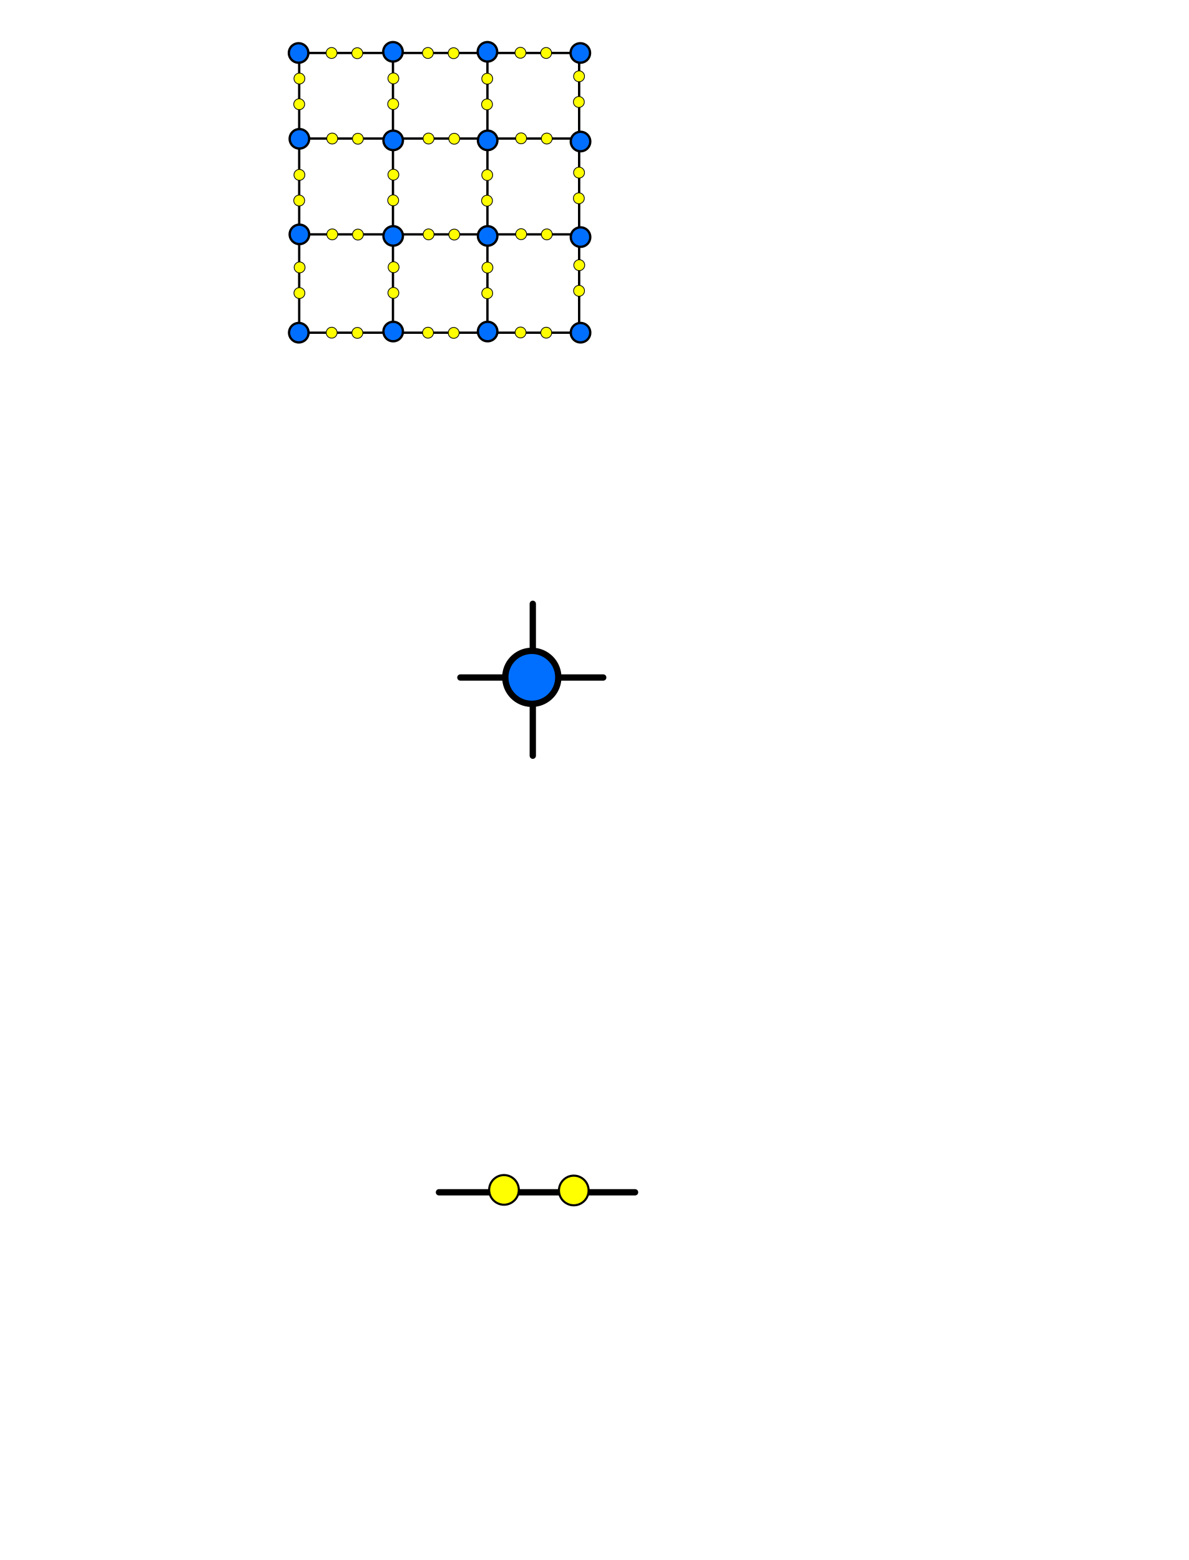
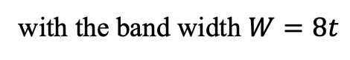
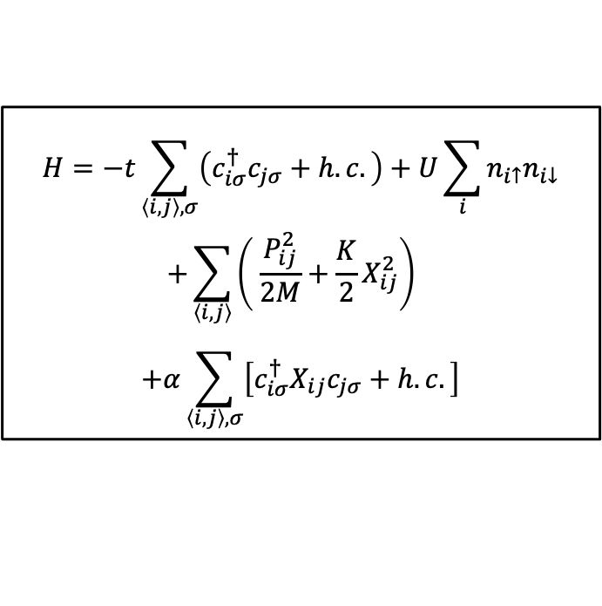
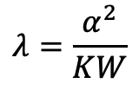
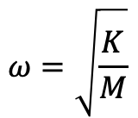
Su-Schrieffer-Heeger-Hubbard (SSHH) model
The SSHH model:
$$H=−t\sum_{\left\langle i,j\right\rangle ,σ}{\left(c_{iσ}^{†}c_{jσ}+h.c.\right)}+U\sum_{i}{n_{i↑}n_{i↓}}$$
$$+\sum_{\left\langle i, j\right\rangle }{\left( \frac{P_{ij}^{2}}{2M}+\frac{K}{2}X_{ij}^{2}\right)}$$
$$+α\sum_{\left\langle i, j\right\rangle ,σ}{\left[c_{iσ}^{†}X_{ij}c_{jσ}+h.c.\right]}$$
$$ω=\sqrt{\frac{K}{M}}$$
Phonon frequency:
The dimensionless EPC constant:
$$λ=\frac{α^{2}}{KW}$$
with the band width $W=8t$
Xun Cai, Zi-Xiang Li, and Hong Yao
Phys. Rev. Lett. 127, 247203 (2021)
Electron site
The model might be relevant to the physics of CuO₂ plane considering B_{1g} phonons.
Phonon site
Notes:
The model we consider is the Su-Schrieffer-Heeger-Hubbard model.
To construct the SSH-Hubbard model need electron site and phonon site.
As shown in the right figure, in a square lattice, the blue points in the vertex are the electron sites, and the yellow points on the bond are the phonon sites.
The Hamiltonian can be written in this form, it contains three parts. The first part is the exactly the Hubbard model, the second part is the phonon part. Xij and Pij are the displacement and momentum operators of the optical SSH phonons on the bond <ij>.The phonon frequency omega equals sqrt root of K over M
And the last part describes the electron-phonon interaction. The displacement field of SSH phonons linearly couple to electron’s nearest-neighbor hopping.The strength of EPC can be characterized by a dimensionless EPC constant lambda=..
(One can regard the model as an approximate realistic model of Copper Oxide plane If we see the electron site as Copper site, and the phonon as the oscillation of oxygen. We hope this model have a good description of Cuprate physics.)

Slide 7
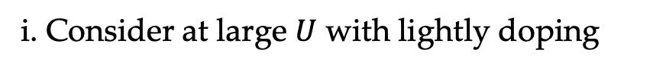
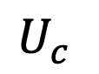
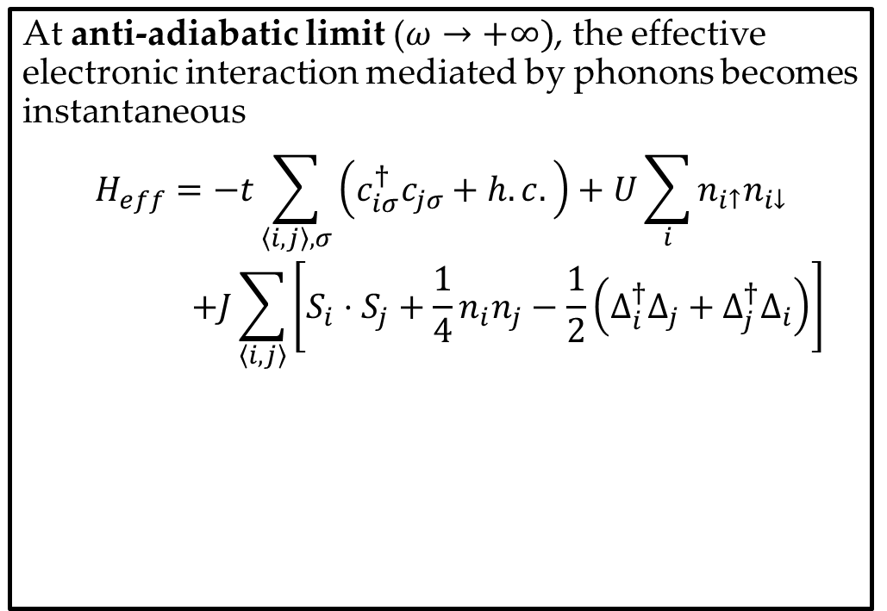
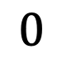
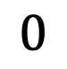
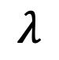
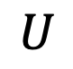
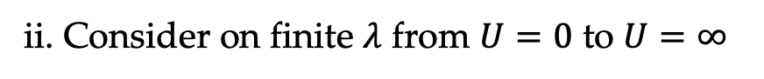
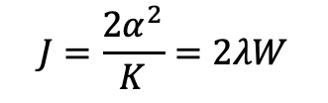
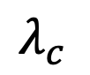
Su-Schrieffer-Heeger-Hubbard (SSHH) model
At anti-adiabatic limit ($ω→+∞)$, the effective electronic interaction mediated by phonons becomes instantaneous
$$H_{eff}=−t\sum_{\left\langle i,j\right\rangle ,σ}{\left(c_{iσ}^{†}c_{jσ}+h.c.\right)}+U\sum_{i}{n_{i↑}n_{i↓}}$$
$$+J\sum_{\left\langle i, j\right\rangle }{\left[S_{i}⋅S_{j}+\frac{1}{4}n_{i}n_{j}−\frac{1}{2}\left(Δ_{i}^{†}Δ_{j}+Δ_{j}^{†}Δ_{i}\right)\right]}$$
i. Consider at large $U$ with lightly doping
$$0$$
$$λ$$
$$λ_{c}^{}$$
Superconductor phase?
Stripe order,
S. R. White, S. Zhang et al. 2020
$$J=\frac{2α^{2}}{K}=2λW$$
ii. Consider on finite $λ$ from $U=0$ to $U=∞$
J-term favors pairing on the same site or between nearest-neighbor sites.
$$0$$
$$U$$
$$U_{c}^{}$$
d-wave SC
BCS, s-wave SC
Notes:
To give some insight, we first investigate the model in a limit. As omega go to infinity, the anti-adiabatic limit, the effective electronic interaction mediated by the phonon becomes instantaneous, so that we can exactly integrate the phonon mode, and the EPC terms are replace by the J term. Where S is the spin operator, n is the charge density operator, and Delta is the on-site pair operator. J equals 2 alpha square over K, proportional to the dimensionless EPC constant lambda. The J term favors electron pairing on-site and on-bond.
We consider the large U case, namely the electron-electron interaction is strong, as in cuprate. When lightly doping the Hubbard model, we get stripe order without superconductor off-diagonal-long-range order, according previous work by White and Zhang. When we increase the EPC strength, the electron pairing should become more competitive. So we hope the EPC may induce a superconductor phase, more concretely, a d-wave superconductor phase.
In the following

Slide 8
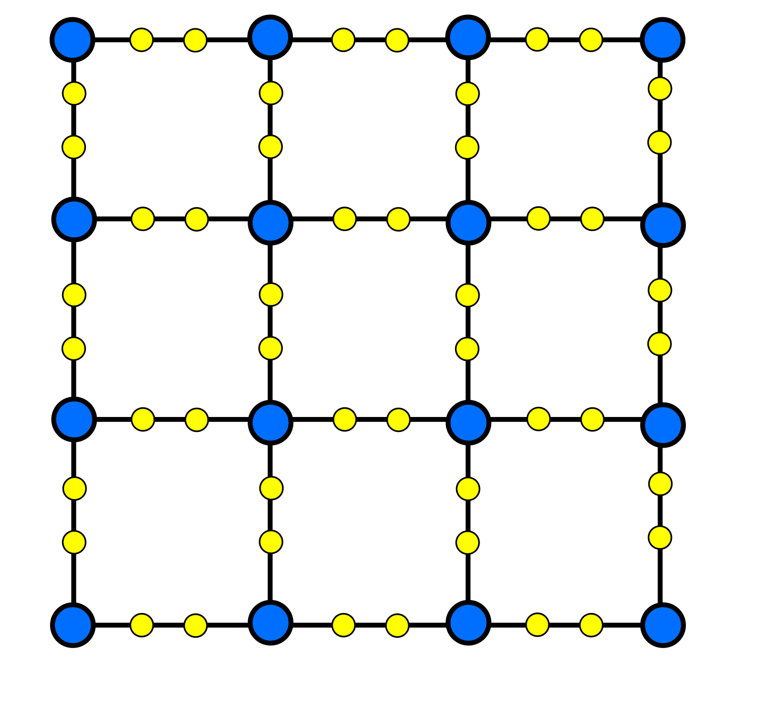
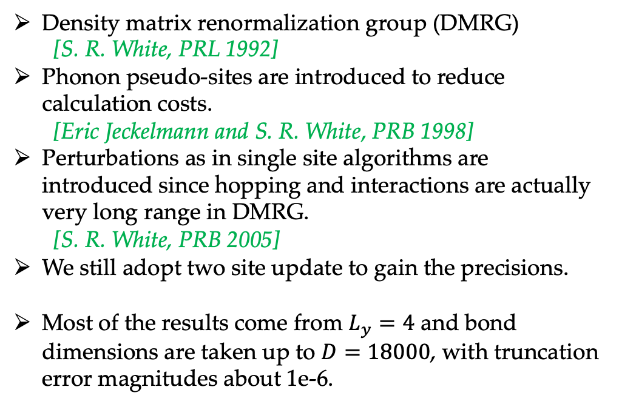
Method
Density matrix renormalization group (DMRG)
[S. R. White, PRL 1992]
Phonon pseudo-sites are introduced to reduce calculation costs.
[Eric Jeckelmann and S. R. White, PRB 1998]
Perturbations as in single site algorithms are introduced since hopping and interactions are actually very long range in DMRG.
[S. R. White, PRB 2005]
We still adopt two site update to gain the precisions.
Most of the results come from $L_{y}=4$ and bond dimensions are taken up to $D=18000$, with truncation error magnitudes about 1e-6.
Phonon pseudo-site
Notes:
Large scale parallel technique(OpenMP & MPI) are adopted to accelerate the calculation.

Slide 9
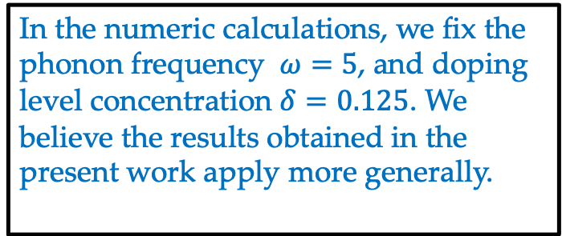
Results: Phase Diagram
In the numeric calculations, we fix the phonon frequency $ω=5$, and doping level concentration $δ=0.125$. We believe the results obtained in the present work apply more generally.

Slide 10
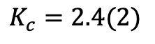
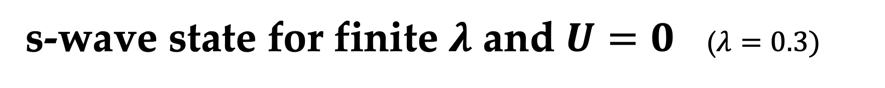
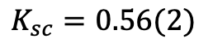
s-wave state for finite $λ$ and $U=0$ ($λ=0.3)$
Chage density profile
half-filled stripe;
quasi-long range SC correlation with Ksc < 1; chage gapless;
spin gapped
Luther-Emery Liquid
SC correlation
Charge density correlation
Spin correlation
$$K_{c}=2.4(2)$$
$$K_{sc}=0.56(2)$$

Slide 11
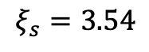
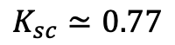
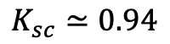
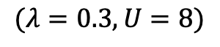
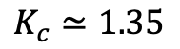
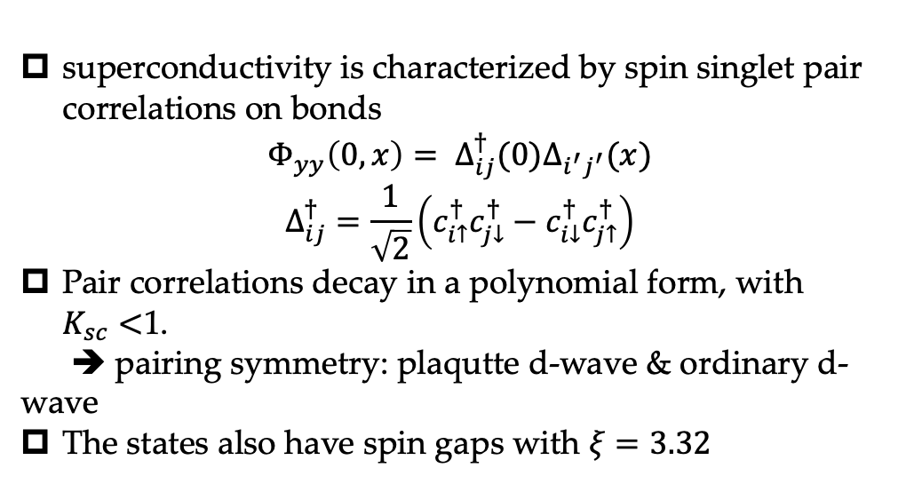
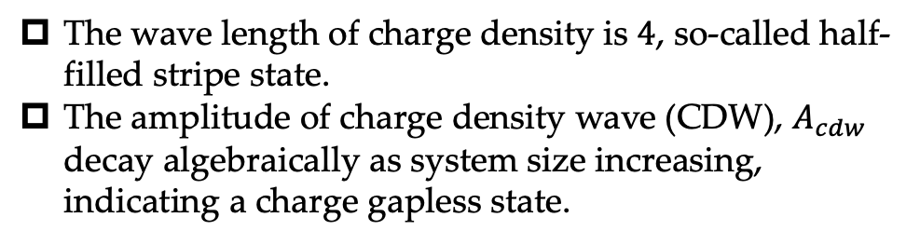
The d-wave SC for moderate EPC and large $U$
$$(λ=0.3, U=8)$$
$$K_{sc}≃0.94$$
$$K_{c}≃1.35$$
superconductivity is characterized by spin singlet pair correlations on bonds
$$Φ_{yy}\left(0, x\right)= Δ_{ij}^{†}(0)Δ_{i^{′}j^{′}}(x)$$
$$Δ_{ij}^{†}=\frac{1}{\sqrt{2}}\left(c_{i↑}^{†}c_{j↓}^{†}−c_{i↓}^{†}c_{j↑}^{†}\right)$$
Pair correlations decay in a polynomial form, with $K_{sc}<$1.
➔ pairing symmetry: plaqutte d-wave & ordinary d-wave
The states also have spin gaps with $ξ=3.32$
The wave length of charge density is $4$, so-called half-filled stripe state.
The amplitude of charge density wave (CDW), $A_{cdw}$ decay algebraically as system size increasing, indicating a charge gapless state.
$$K_{sc}≃0.77$$
$$ξ_{s}=3.54$$

Slide 12

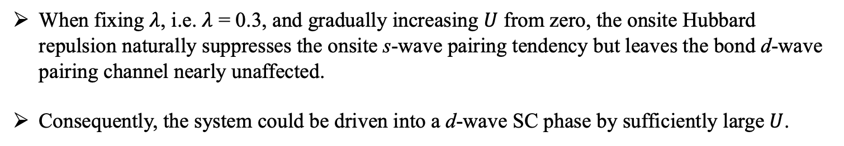
SC evolution from s-wave to d-wave
s-wave pairing
d-wave pairing
$$U$$
When fixing $λ$, i.e. $λ$ = 0.3, and gradually increasing $U$ from zero, the onsite Hubbard repulsion naturally suppresses the onsite s-wave pairing tendency but leaves the bond d-wave pairing channel nearly unaffected.
Consequently, the system could be driven into a d-wave SC phase by sufficiently large$U$.

Slide 13
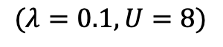
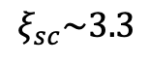
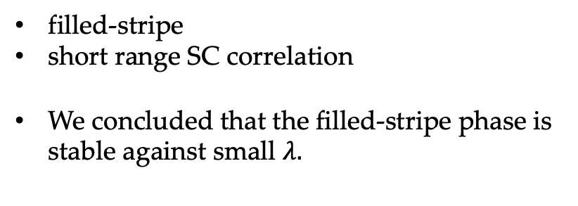
stripe state
$$(λ=0.1, U=8)$$
$$ξ_{sc}\sim 3.3$$
filled-stripe
short range SC correlation
We concluded that the filled-stripe phase is stable against small $λ.$

Slide 14
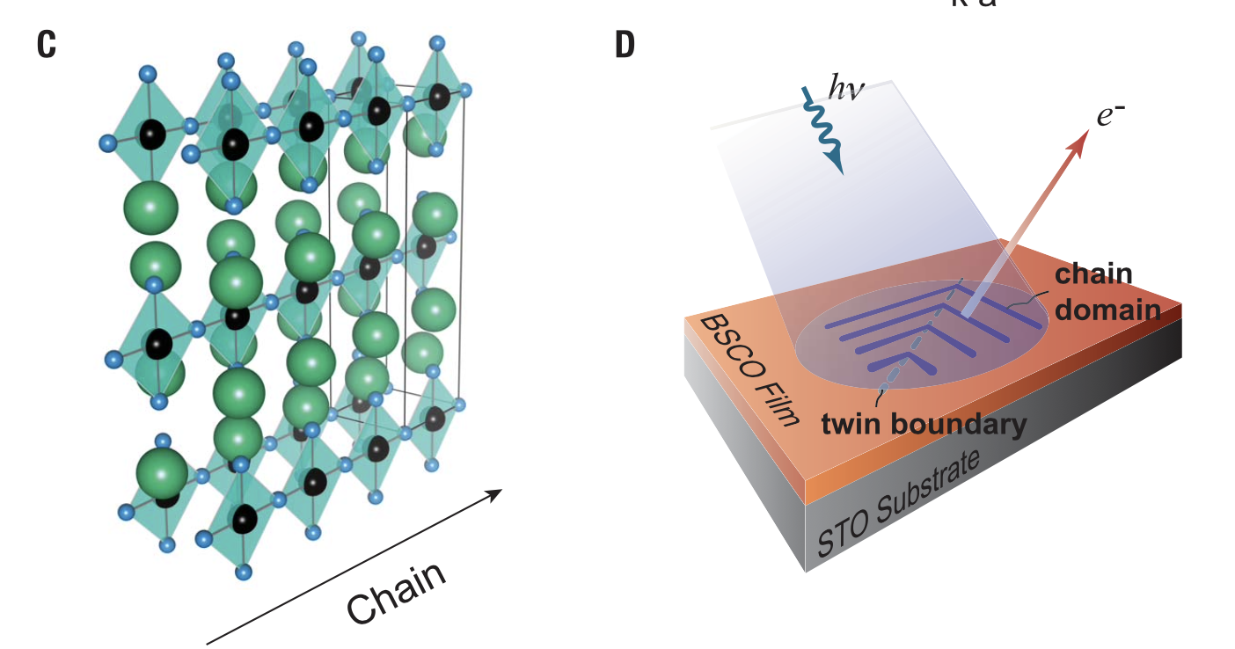
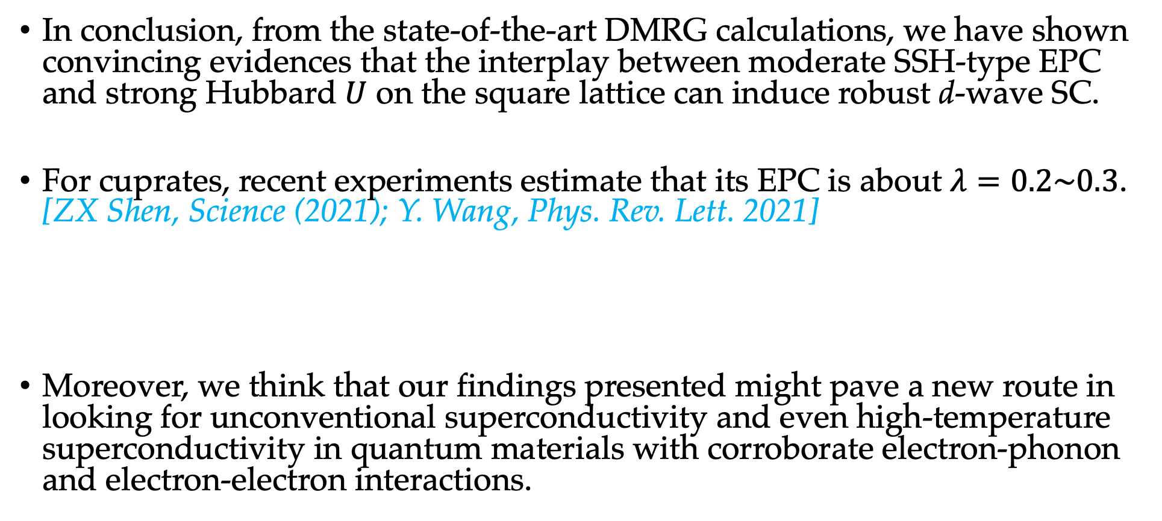
Discussion & Summary
In conclusion, from the state-of-the-art DMRG calculations, we have shown convincing evidences that the interplay between moderate SSH-type EPC and strong Hubbard $U$ on the square lattice can induce robust d-wave SC.
For cuprates, recent experiments estimate that its EPC is about $λ=0.2\sim 0.3$. [ZX Shen, Science (2021); Y. Wang, Phys. Rev. Lett. 2021]
Moreover, we think that our findings presented might pave a new route in looking for unconventional superconductivity and even high-temperature superconductivity in quantum materials with corroborate electron-phonon and electron-electron interactions.

Slide 15
Thanks for your attention!

Slide 16
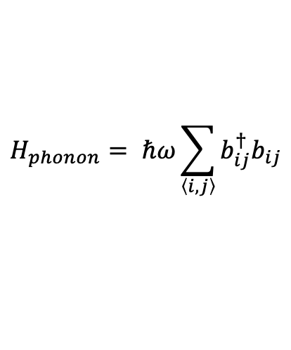
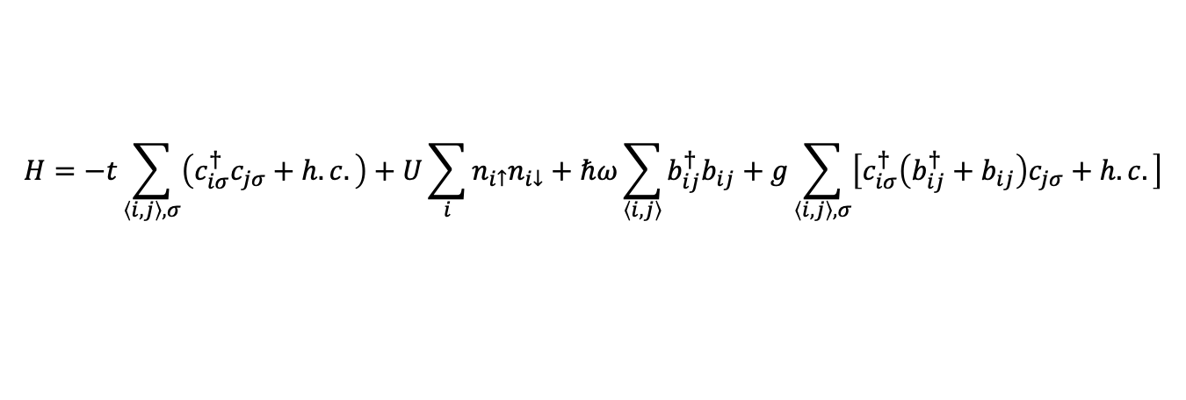
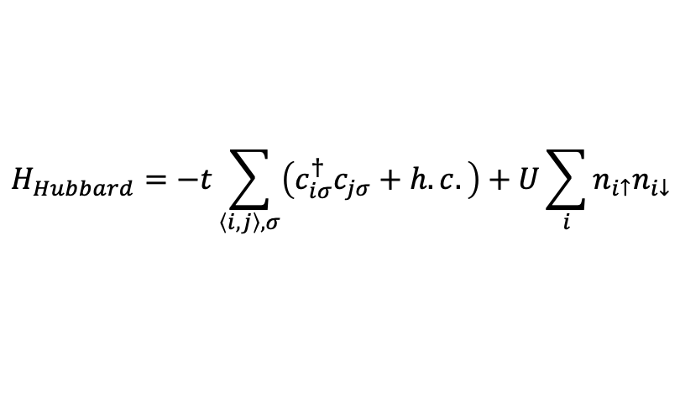

Su-Schrieffer-Heeger(SSH)-Hubbard model
$$H=H_{Hubbard}+H_{phonon}+H_{e−p}$$
$$H_{Hubbard}=−t\sum_{\left\langle i,j\right\rangle ,σ}{\left(c_{iσ}^{†}c_{jσ}+h.c.\right)}+U\sum_{i}{n_{i↑}n_{i↓}}$$
$$H_{phonon}= ℏω\sum_{\left\langle i, j\right\rangle }{b_{ij}^{†}b_{ij}}$$
$$H=−t\sum_{\left\langle i,j\right\rangle ,σ}{\left(c_{iσ}^{†}c_{jσ}+h.c.\right)}+U\sum_{i}{n_{i↑}n_{i↓}}+ℏω\sum_{\left\langle i, j\right\rangle }{b_{ij}^{†}b_{ij}}+g\sum_{\left\langle i, j\right\rangle ,σ}{\left[c_{iσ}^{†}\left(b_{ij}^{†}+b_{ij}\right)c_{jσ}+h.c.\right]}$$
Electron site (Cu)
Phonon site (O)

